Slide 1
Relational DataBase Management Systems (RDBMS)
Wiem jaballah

Slide 2
A database is an organized collection of structured information, or data, typically stored electronically in a computer system. A database is usually controlled by a database management system (DBMS). Together, the data and the DBMS, along with the applications that are associated with them, are referred to as a database system, often shortened to just database.
Data within the most common types of databases in operation today is typically modeled in rows and columns in a series of tables to make processing and data querying efficient. The data can then be easily accessed, managed, modified, updated, controlled, and organized. Most databases use structured query language (SQL) for writing and querying data.

Slide 3
Before creating these tables, the RDBMS must check the following constraints:
• Primary keys : this identifies each row in the table. One table can only contain one primary key. The key must be unique and without null values.
• Foreign keys : this is used to link two tables. The foreign key is kept in one table and refers to the primary key associated with another table.
• Not null : this ensures that every column does not have a null value, such as an empty cell.
• Check : this confirms that each entry in a column or row satisfies a precise condition and that every column holds unique data.
• Data integrity : the integrity of the data must be confirmed before the data is created.

Slide 4
Assuring the integrity of data includes several specific tests, including entity, domain, referential and user-defined integrity. Entity integrity confirms that the rows are not duplicated in the table.
Domain integrity makes sure that data is entered into the table based on specific conditions, such as file format or range of values. Referential integrity ensures that any row that is re-linked to a different table cannot be deleted.
Finally, user-defined integrity confirms that the table will satisfy all user-defined conditions.

Slide 5
Benefits
The primary benefit of the relational database approach is the ability to create meaningful information by joining the tables. Joining tables allows you to understand the relationships between the data, or how the tables connect. SQL includes the ability to count, add, group, and also combine queries. SQL can perform basic math and subtotal functions and logical transformations. Analysts can order the results by date, name, or any column.
Those features make the relational approach the single most popular query tool in business today.
Relational databases have several advantages compared to other database formats:

Slide 6
Flexibility
SQL has its a built-in language for creating tables called Data Definition Language (DDL). DDL allows you to add new columns, add new tables, rename relations, and make other changes even while the database is running and while queries are happening. This allows you to change the schema or how you model data on the fly.
Reduced redundancy
Relational databases eliminate data redundancy. The information for a single customer appears in one place—a single entry in the customer table. The order table only needs to store a link to the customer table. The practice of separating the data to avoid redundancy is called normalization. Progressional database designers make sure the tables normalize during the design process.
Ease of backup and disaster recovery
Relational databases are transactional—they guarantee the state of the entire system is consistent at any moment. Most relational databases offer easy export and import options, making backup and restore trivial. These exports can happen even while the database is running, making restore on failure easy. Modern, cloud-based relational databases can do continuous mirroring, making the loss of data on restore measured in seconds or less. Most cloud-managed services allow you to create Read Replicas, like in IBM Cloud Databases for PostgreSQL. These Read Replicas enable you to store a read-only copy of your data in a cloud data center. Replicas can be promoted to Read/Write instances for disaster recovery as well.

Slide 7
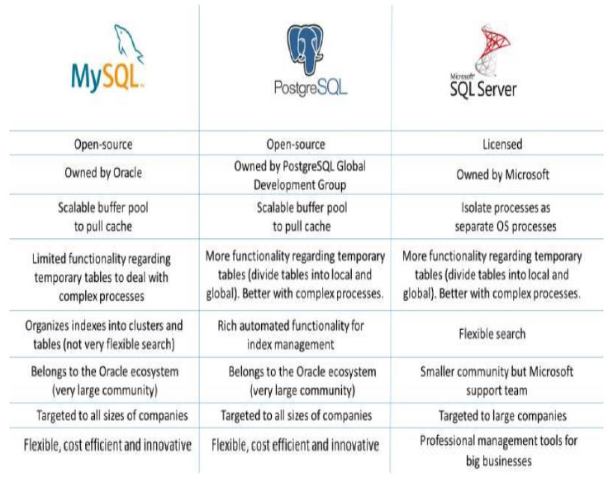
Comparison between the three RDBMS

